Slide 1
Student details
STUDENT NAME : D.NEHA SINGH
REGISTER NO : 222403604
NMID : 1DFDA2830F2C97393124DE58E8CFA3A7
DEPARTMENT: COMPUTER SCIENCE WITH ARTIFICIAL INTELLIGENCE
COLLEGE: SRI DEVI ARTS & SCIENCE COLLEGE

Slide 2
PROJECT TITLE
PRODUCT LANDING PAGE

Slide 3

AGENDA
Problem Statement
Project Overview
End Users
Tools and Technologies
Portfolio design and Layout
Features and Functionality
Results and Screenshots
Conclusion
Github Link
3/21/2024 Annual Review

Slide 4
PROBLEM STATEMENT
Clearly communicates the product’s features, benefits, and value proposition.
Builds trust through social proof (e.g., testimonials, reviews, case studies).
Guides visitors toward a specific action (e.g., purchase, sign-up, download).
Loads quickly and performs well across devices (mobile, tablet, desktop).
Is visually appealing and aligns with the brand identity.

Slide 5
PROJECT OVERVIEW
Purpose
The main goal of the product landing page is to:
Attract potential customers through targeted marketing campaigns (e.g., ads, emails, SEO).
Provide key information about the product in a compelling and digestible format.
Build user trust through testimonials, reviews, and product guarantees.
Persuade visitors to take a specific action with clear CTAs.
Benefits
Increases product visibility.
Improves user engagement.
Drives higher conversion rates.
Provides measurable analytics for marketing performance.

Slide 6
WHO ARE THE END USERS?
Examples:
1. Potential Customers
2. Returning Customers
3. Product Reviewers / Influencers
4. Investors or Stakeholders
5. Internal Marketing & Sales Teams

Slide 7
TOOLS AND TECHNIQUES
TOOLS & TECHNIQUES FOR A PRODUCT LANDING PAGE
1. Design Tools
Used for visual design, wireframes, and UI/UX prototyping.
Figma
Adobe XD
2. Development Tools
Used to code and build the actual landing page
HTML,CSS, JavaScript
3. CMS / Landing Page Builders
4. Marketing & SEO Tools

Slide 8
PRODUCT LANDINGPAGE DESIGN AND LAYOUT
✅ Design Principles to Follow
Consistency:
Whitespace
Mobile-First
Accessibility
Speed Optimization
8

Slide 9
FEATURES AND FUNCTIONALITY
✅ Features
Eye-catching hero section with headline & CTA
Product overview with images and icons
Fast loading with optimized assets
⚙️ Functionalities
Fully responsive on mobile, tablet, and desktop
Customer testimonials and star ratings
SEO-friendly structure and meta tags

Slide 10
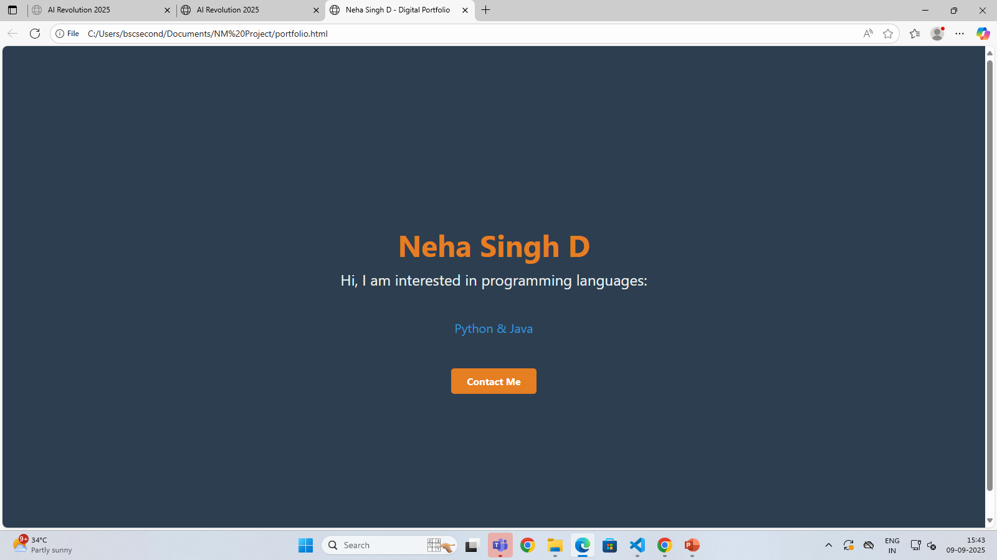

RESULTS AND SCREENSHOTS
3/21/2024 Annual Review
10

Slide 11
CONCLUSION
The product landing page is essential for attracting and converting users.
It highlights key features, benefits, and customer trust elements.
A clean, responsive design ensures a smooth user experience.
Clear CTAs guide visitors toward desired actions.
Overall, it serves as a powerful tool to boost engagement and sales.
11

Slide 12
Github link:
https://github.com/dnehasingh24912bscai-creator/nehasingh_222403604.git

